Slide 1
library management system
By: Bushra Khan ECA-7469

Slide 2

introduction
Effectively Manage, Track, and Perform Daily Library Operations with Ease!

Slide 3

Future enhancements
Fully secured & maintenance-free library software
Backup and recovery provision
User-defined privileges & supports e-book uploading & reading
Mobile App

Slide 4
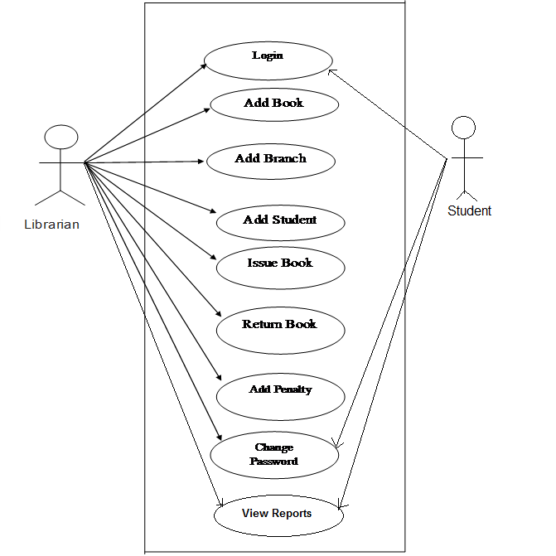
Use case diagram

Slide 5
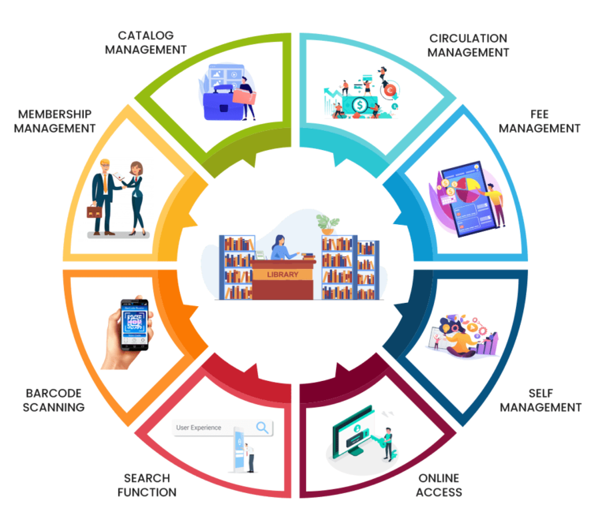
biography
The purpose of a library management system is to operate a library with efficiency and at reduced costs. The system being entirely automated streamlines all the tasks involved in operations of the library. The activities of book purchasing, cataloging, indexing, circulation recording and stock checking are done by the software. Such software eliminates the need for repetitive manual work and minimizes the chances of errors. The library management system software helps in reducing operational costs. Managing a library manually is labor intensive and an immense amount of paperwork is involved. An automated system reduces the need for manpower and stationery. This leads to lower operational costs.

